Slide 1
DIGITAL PORTFOLIO
STUDENT NAME :K.V.HARIPRASAD
REGISTER NO :24134101802521002
NM ID :CA9DA1EF28459DC807E4E8759A93E16F
DEPARTMENT :B.Sc., COMPUTER SCIENCE
COLLEGE :BEST ARTS AND SCIENCE COLLEGE,SIRKALI

Slide 2
PROJECT TITLE
Creative Student portfolio using FWD

Slide 3
AGENDA
Problem Statement
Project Overview
End Users
Tools And Technologies
Portfolio Design And Layout
Features And Functionality
Results And Screenshots
Conclusion
Github link

Slide 4
PROJECT OVERVIEW
Portfolio Contains About Me, Projects, Skills, Contact And Pictures

Slide 5
PROBLEM STATEMENT
In Today Digital Era Traditional Resume Alone Are Not Enough To Showcase Skills And Projects Effectively. Many Students And Professionals Lack A Structures Online Presence To Highlight Their Work. A Digital Portfolio Provides An Interactive And Accessible Platform To Present Achievements, Skills And Experiences.

Slide 6
WHO ARE THE END USERS?
STUDENTS(academic projects, resumes)
JOB SEEKERS(to share with recruiters)
PROFESSIONALS(to show clients)
SOFTWARE EMPLOYEE

Slide 7
PORTFOLIO DESIGN AND LAYOUT
HTML – Pages Sections
CSS-LAYOUT – colors,font
JAVASCRIPT-interactive navigation,form validation
VS CODE – implementation code editor, github link

Slide 8
TOOLS AND TECHNIQUES
SECTION
HOME
PROJECTS
SKILLS
CONTACT
MOBILE/DESKTOP/TABLET

Slide 9
FEATUERS AND FUNCTIONALITY
NAVIGATION BAR WITH SMOTH SCROLLING
IMAGE DETAILS/HYPERLINKS
INTERACTIVE ELEMENTS – ANIMATIONS, HOVER EFFECTS,BACKGROUND COLOUR CHANGE
CONTACT FROM VALIDATE

Slide 10
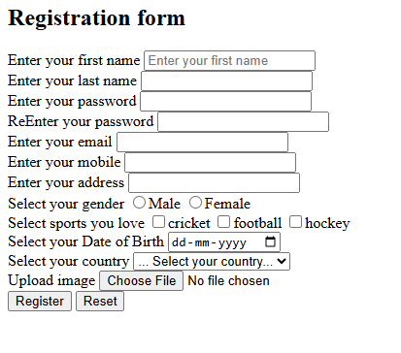
RESULTS AND SCREENSHOT

Slide 11
CONCLUSION
Easy To Share With Recruiters It Makes Online Presence

Slide 12
GITHUB LINK

